Slide 1
IKEA PoC

Slide 2

Logo to be used
Use the following logo – across all use cases & clickable prototype. Download from https://en.wikipedia.org/wiki/IKEA

Slide 3
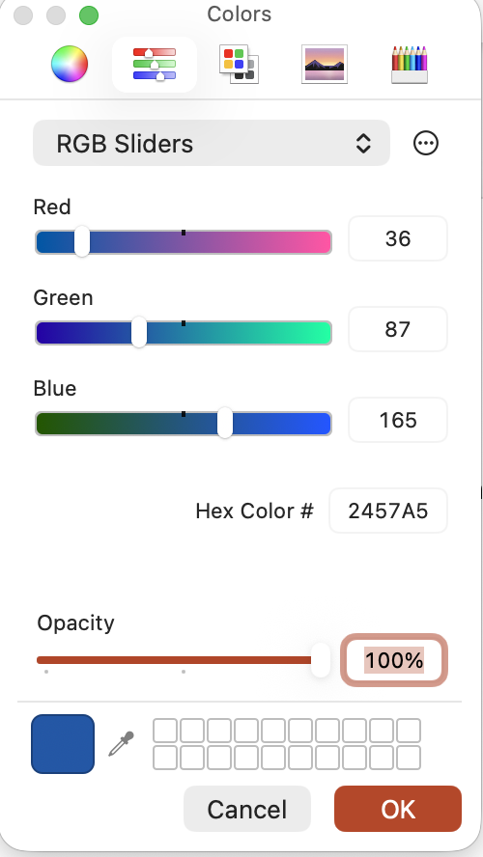
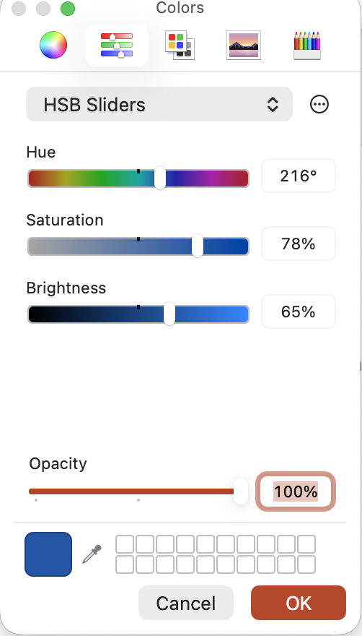
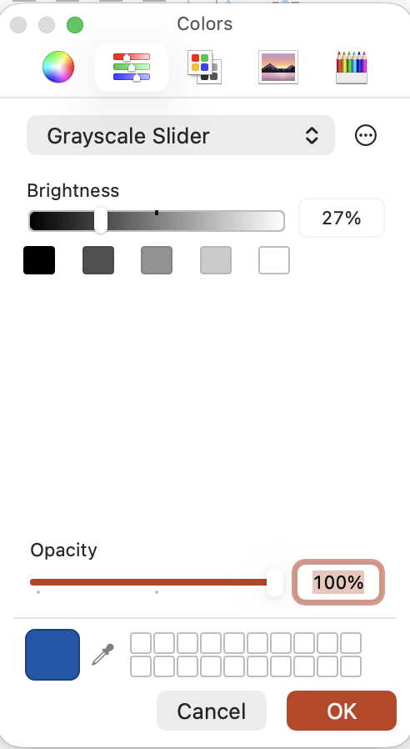
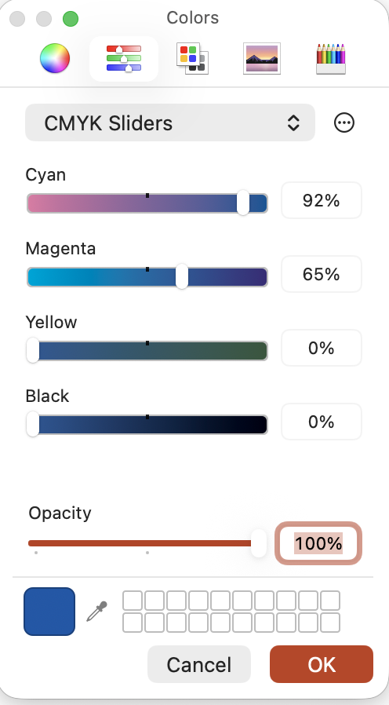
Colour themes to be used
Use the IEKA blue where needed & teams framework allows
Use the picker on the logo or the values shown below for exact match

Slide 4
AskP&C icon/brand
Use this icon to represent AskP&C visually
Use this image
P&C

Slide 5
Before login (use only if there is a login page)
I’m not sure the limitations /possibilities in Teams. We can discuss this.
Top center – IKEA logo
Top right – language selection dropdown (???)
Page center - display message – “Hej!”
Below the greetings, provision for entering User Name and Password
”LOGIN” button – white text with IKEA blue background

Slide 6
Post login, greetings & messages (MS Teams interface)
Top bar – left corner – show the IKEA logo with “AskP&C” next to it
Chat window –
Display – “AskP&C” followed by time (hh:mm format)
Default message–
display AskP&C Icon (instead of the IKEA logo that is used currently)
Display message “Hej! <<<name of the person>>>, (next line) I’m AskP&C”. Text colour black (0,0,0)
Below the display message add the disclaimer text “AskP&C uses Generative AI and may provide inaccurate output. Review outputs carefully”. Use the RGB (127,127,127) for the disclaimer text
In the box where user is expected to type show default text “Type something… ” (127,127,127). Below the user interaction box – show four top use cases
Update My Personal Information
View My Payslip
View My Shift Schedule
Request Time Off
User should be able to either enter their query in the chatbox OR select one of the default use cases listed

Slide 7
User interaction
User should be able to either type into the chatbox OR select from the default use cases listed
If user selects no.1 or no. 2 default use cases, branch out to the relevant use case
If user selects no. 4 from the default list display the following response
- “Request Time Off feature is currently not enabled in AskP&C. We are working making it available to you soon.”
- “ You may visit the HR portal to Request Time Off – Link to HR Portal”
- “ In the mean time, here is a prototype of Leave Of Absence feature. You may explore it further by following this link” (hyperlink the prototype to Santosh’s page)
If user selects no. 3 from the default list display the following response
-“View My Shift Schedule is currently not enabled in AskP&C. We are working making it available to you soon.”
-“You may reach out to your Store Manager for assistance with your Shift Schedule”
5. If user types a query related to Personal information update or View payslip or When will I be paid, branch out to the right use case
6. If user types a query related to Time Off OR Shift Schedule use the response listed above in #3 and #4
7. If user types a query related to Leave of Absence, display the following response
- “Leave Of Absence feature is currently not enabled in AskP&C. We are working making it available to you soon.”
- “ You may visit the HR portal to request Leave Of Absence – Link to HR Portal”
- “ In the mean time, here is a prototype of Leave Of Absence feature. You may explore it further by following this link” (hyperlink the prototype to Santosh’s page)

Slide 8
User interaction (contd)
8. If the user types something else all together (e.g.: my insurance plan, group benefits enrollment, my overdue learnings…) it needs to be handled as follows,
1. System should use the intelligence to identify the underlying usecase and show a response
- “<<xyz>> feature is currently not enabled in AskP&C. We are working on making it available to you soon.”
- “You may visit the <<abc>> portal to find more information on this”
2. If it’s shift related query (swap my shift, shift timings etc.) display the message
- “<<xyz>> feature is currently not enabled in AskP&C. We are working on making it available to you soon.”
- “You may reach out to your Store Manager for assistance on this”
If we have the knowledge articles, sources etc. we may bring the link in our responses.
What does it entail to make the system intuitive and contextual? How much training does it need and what kind of training data will we need, even for the system to redirect the queries to the right place?

Slide 9
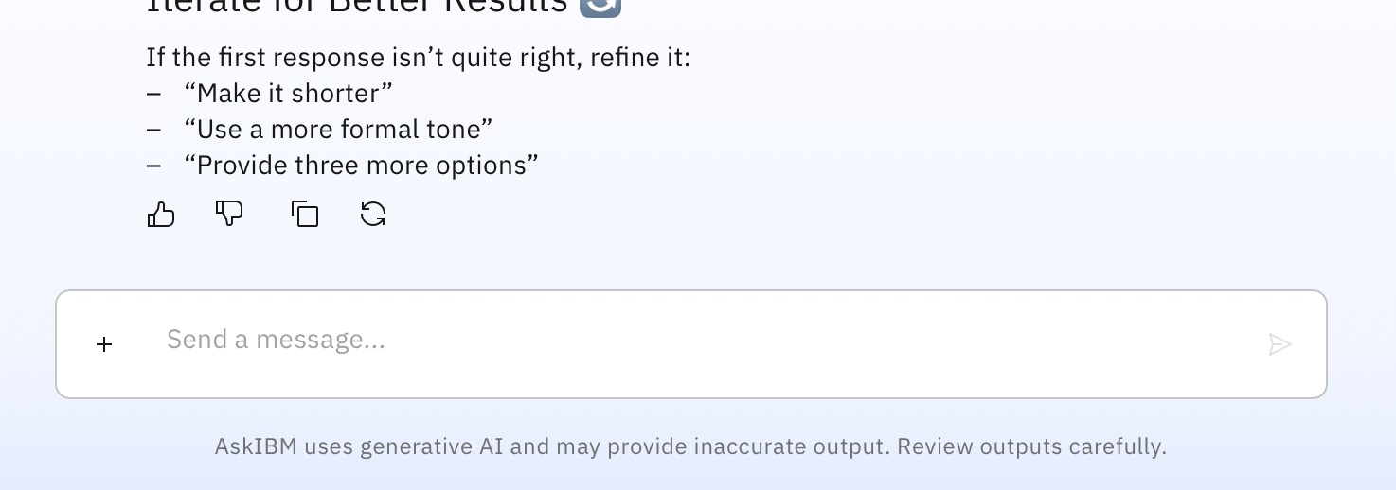
Feedback
Post user interaction, feedback capture should take place
User should be given the option to - thumbs up (I like this response), thumbs down (I dislike this response), copy (Copy response), regenerate (Regenerate response) options (Refer to the screen shot from AskIBM below.

Slide 10
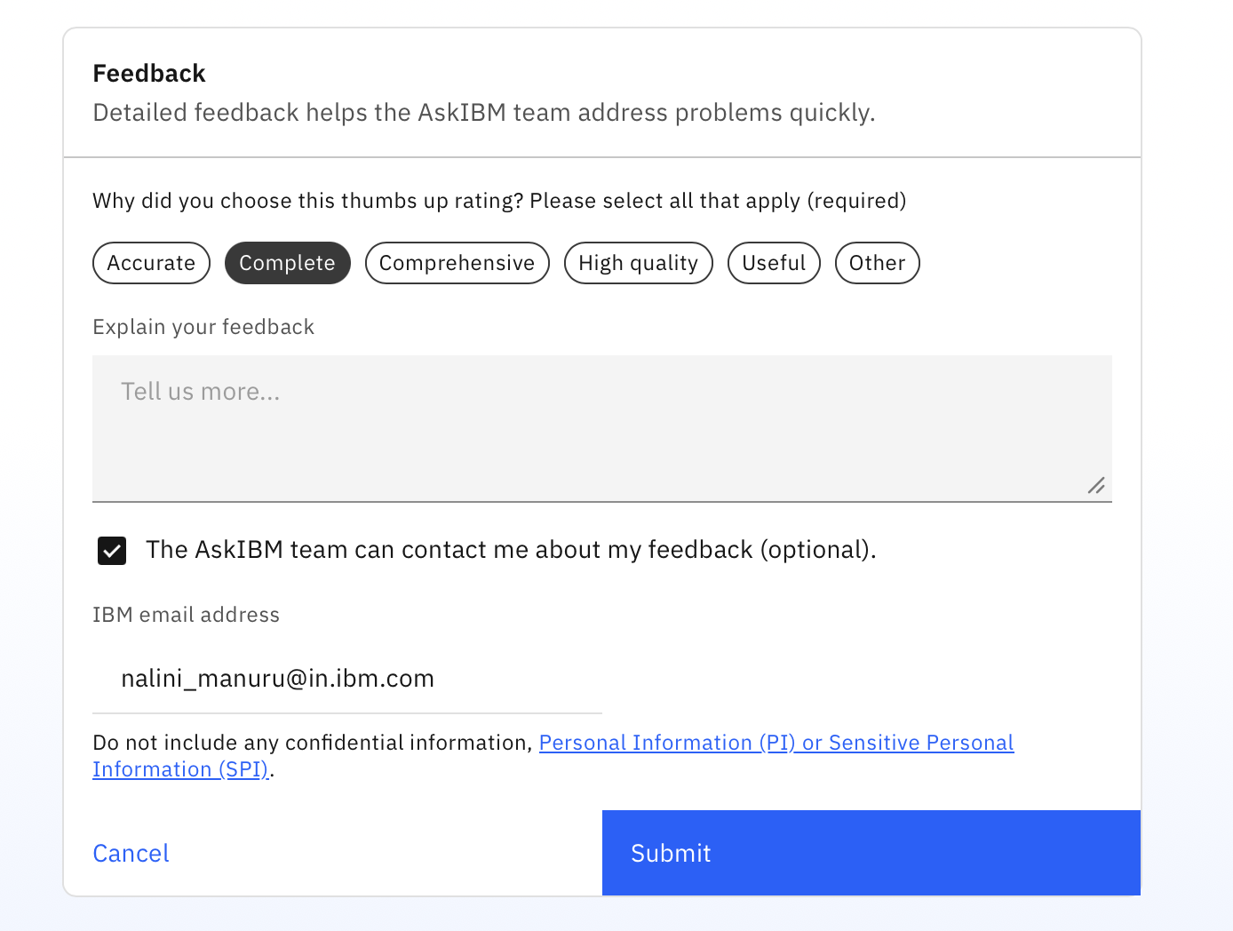
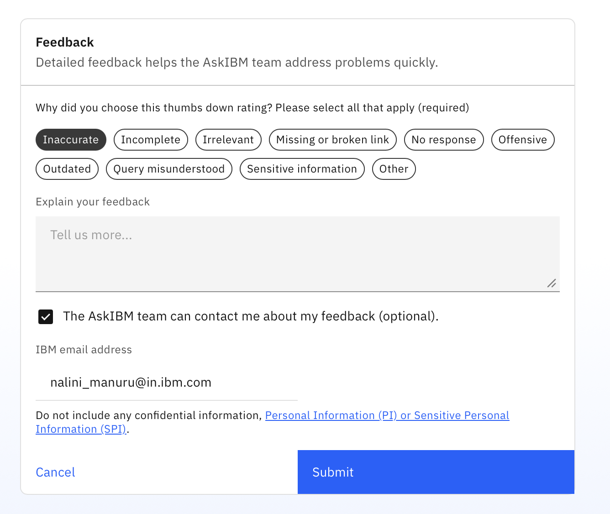
Feedback (continued)
Flow for when user likes or dislikes responses

Slide 11
Feedback (continued)
Regenerate response should run the query again and provide a response.

